Slide 1



Slide 2

Our Mission: To improve the well-being and permanence of children and their families by providing adoption competent mental health services, advancing learning to build a responsive national network of professionals, and transforming policy and practice through research and advocacy.
Pre- and post-adoption counseling, assessment and therapeutic services
Individual and group therapy (in-person & teletherapy) for kids, teens and adults
Nationally recognized post-adoption models
Educational & interactive workshops for families and professionals
Adoption competency workforce development for child welfare, mental health and school professionals
Award-winning print publications, articles, newsletters and online resources
For more information, visit
www.adoptionsupport.org

Slide 3
What is NTI?
What’s its impact?
What do training participants typically ask?
What does NTI look like in real-time?

Slide 4
What is NTI?
What’s its impact?
What do training participants typically ask?
What does NTI look like in real-time?

Slide 5

Free
Web-based
Self-paced
State-of-the-art
Interactive
Developed with adult learning principles

Slide 6





School Based Professionals Training
18 hours for staff; 21 hours for supervisors
7 modules
Casework focused
Supervisor Coaching and Activity Guide and coaching available
Child Welfare Professionals across the continuum in public & private settings.
27 hours
9 modules
Clinically focused on assessment & treatment planning
Mental Health Professional Coaching Guide and coaching available
Mental Health Professionals in public or private settings
18 hours
8 modules
Clinically focused with more school-based scenarios; includes support for classroom teachers
Pacing Guides and Coaching are available
Mental Health Professionals in school settings, school health clinics
NTI was funded through a 5-year cooperative agreement between C.A.S.E. and the US Department of Health and Human Services, Administration for Children and Families, Children's Bureau, Grant #90CO1121 & #90CO1144.
Free NASW & NBCC approved CEU’s provided for all trainings via CASEInstitute LMS

Slide 7

NTI Competencies
Making a Case for Adoption Competency & Need for Permanency
Understanding Children’s Mental Health Challenges
Re-building and Strengthening Attachment
Healing from Loss and Grief
Impact of Trauma on Brain Development
Supporting Positive Identity Formation
Providing Post-Adoption Supports
Assessment and Treatment Planning through an Adoption Lens
Therapeutic Parenting Strategies to Address Challenging Behaviors

Slide 8

NTI provides skills, strategies, and tools to:
Support children to heal from trauma and loss.
Provide parents with skills to parent more effectively.
Improve child and family well-being to increase family stability.

Slide 9
What is NTI?
What is its impact?
What do training participants typically ask?
What does NTI look like in real-time?

Slide 10
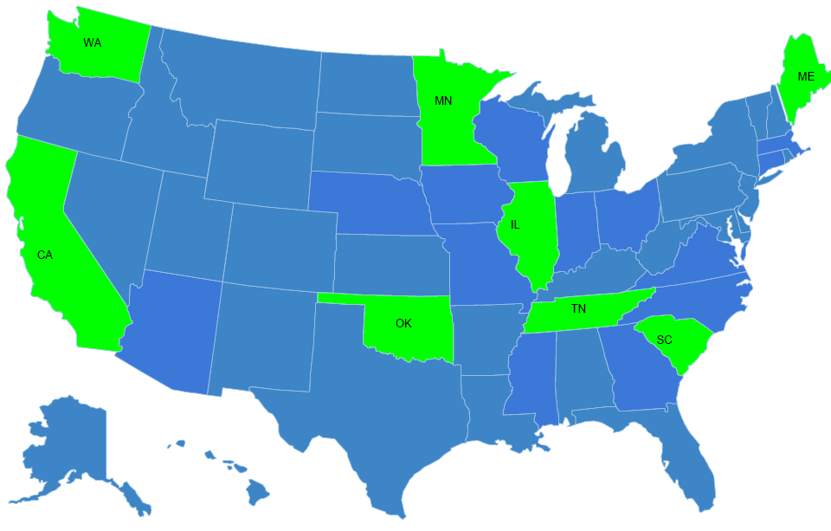
NTI Training Pilot – 2017/2018
Cohort - 8 states and The Cherokee Nation
Child Welfare Training Pilot
January 2017 – January 2018
6,149 child welfare professionals enrolled (4,613 staff and 1,536 supervisors)
72.5% completion rate
Workers had an average of 7 years experience in child welfare
Supervisors had an average of 15 years experience in child welfare
Mental Health Training Pilot:
April 2018 – September 2018
2,823 enrolled
52% completion rate
64% were licensed
10 years average clinical experience/8 years experience with adoption

Slide 11
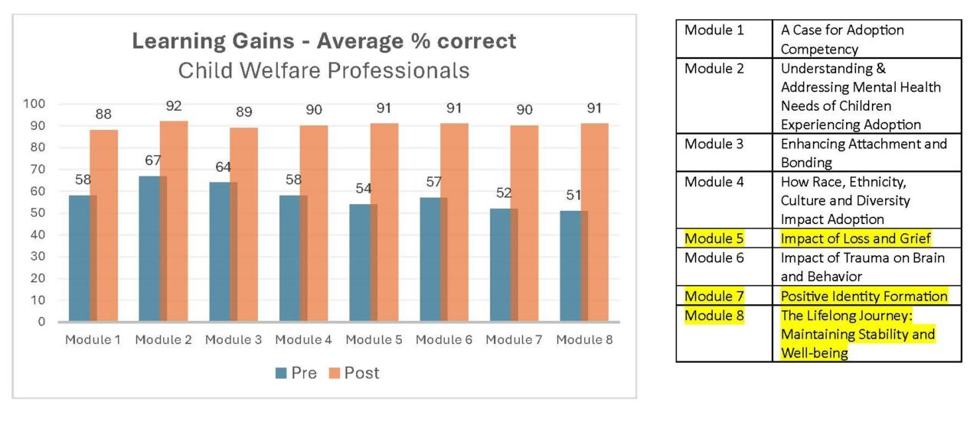
Child Welfare Findings: Average Pre- and Post-test Scores
Between Oct 2023 & March 2024
1167 enrollees & 287 completers
611 CWP 169 CWP
104 CWS 18 CWS
452 MHP 100 MHP
Module 1 | A Case for Adoption Competency
Module 2 | Understanding & Addressing Mental Health Needs of Children Experiencing Adoption
Module 3 | Enhancing Attachment & Bonding
Module 4 | Exploring How Family & Relational Influences Impact Child Well-Being
Module 5 | Impact of Loss and Grief
Module 6 | Impact of Trauma on Brain & Behavior
Module 7 | Positive Identity Formation
Module 8 | The Lifelong Journey: Maintaining Stability and Well-being

Slide 12
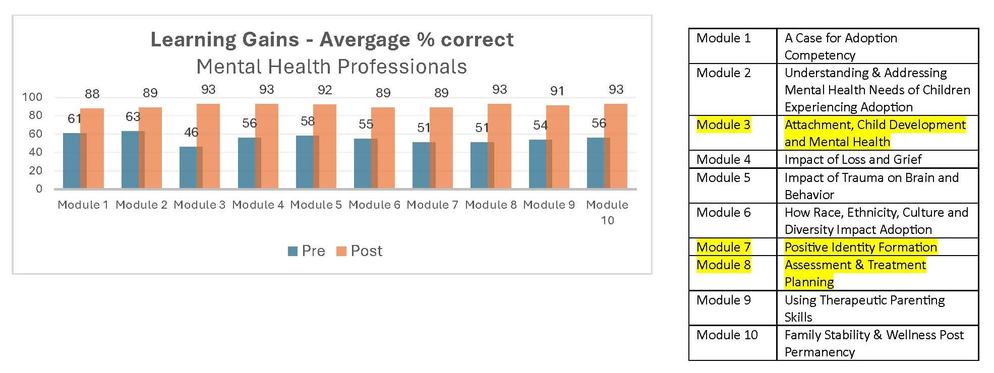
Mental Health Findings: Average Pre- and Post-test Scores
Module 1 | A Case for Adoption Competency
Module 2 | Understanding & Addressing Mental Health Needs of Children Experiencing Adoption
Module 3 | Attachment, Child Development, and Mental Health
Module 4 | Impact of Loss and Grief
Module 5 | Impact of Trauma on Brain & Behavior
Module 6 | Exploring How Family & Relational Influences Impact Child Well-Being
Module 7 | Positive Identity Formation
Module 8 | Assessment & Treatment Planning Through Adoption Lens
Module 9 | Using Therapeutic Parenting Skills
Module 10 | Family Stability & Wellness Post Permanency

Slide 13
How has NTI Impacted Child Welfare Participants? A sample of participants Oct 23-March 24
Most NTI participants reported impacts of NTI on their skills, attitudes, and effectiveness.

Slide 14
What is the impact of not understanding the needs of children and families we are serving?
“We should explain to the children the reasons they left their parent's home.
I really did not know that this should be told. By completing the training, I understand the reasons behind that now.”

Slide 15
What is NTI?
What’s its impact?
What do training participants typically ask?
What does NTI look like in real-time?

Slide 16
What helps to support NTI training completion?
FAQ #1

Slide 17
Most Frequently Used Strategies

Slide 18
In what ways does this help mental health and child welfare professionals?
FAQ #2

Slide 19
Relevance and satisfaction – Oct ’23 – March ‘24

Slide 20
How can I bring NTI to my organization?
FAQ #3

Slide 21
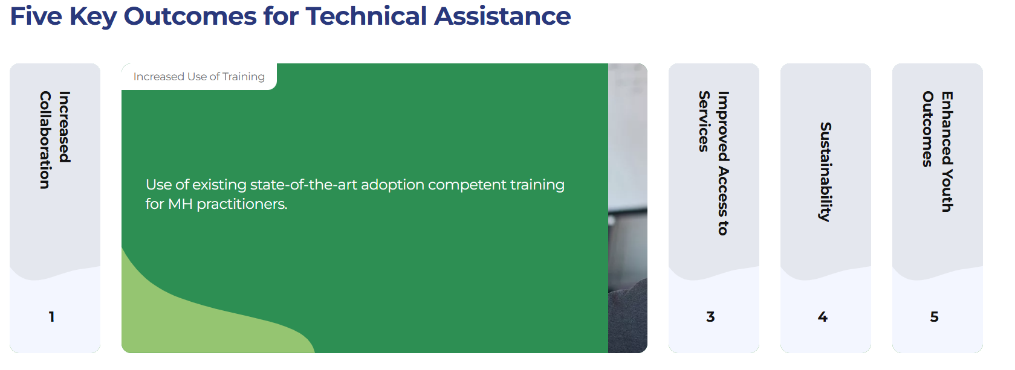

Slide 22


Dawn Wilson, Director, National Training Institute
wilson@adoptionsupport.org
LaShawnda Kilgore, Training & Implementation Specialist
kilgore@adoptionsupport.org
Edna Davis-Brown, Training & Implementation Specialist
davis_brown@adoptionsupport.org
Shamele Hill, Training & Implementation Specialist
hill@adoptionsupport.org
www.adoptionsupport.org @nti.case www.facebook.com/nti.case

Slide 23
What is NTI?
What’s its impact?
What do training participants typically ask?
What does NTI look like in real-time?

Slide 24



Slide 25


Slide 26
