Slide 1
Engaging Families in Child Welfare and Mental Health Services
December 17, 2024
Presented by Pat Hunt

Slide 2
Learning Objectives
Participants will…
Explore the results of over 30 years of research
Learn about various functions families can serve in state and local agencies
Know strategies for engaging families in their child’s care, agency decisions, and policy recommendations

Slide 3
Engaging Families is Everyone’s Business
SYSTEM
CHILD/YOUTH
Engaging Families Yields Positive Outcomes in Every Aspect of Care
COMMUNITY
FAMILY
AGENCY
or
FACILITY
MANAGED CARE
This graphic depicts how action in one part of the system influences another – the center ring shows a madras effect of the colors bleeding from one to another.

Slide 4
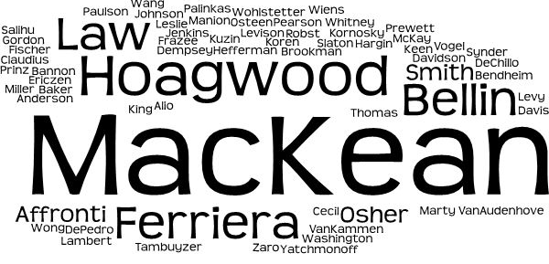
Who else says that engaging families is important?
More than 65 researchers do!

Slide 5
Engaging Families Yields Positive Outcomes
Reflects the involvement of fathers
System
Community
Managed Care
Agency / Facility
Family
Child / Youth
More effective and efficient use of state and federal resources among systems
Reduced out of home placements
Shorter LOS in residential care
Self efficacy reduces over-reliance on services
Improves data for decision making
Improves community tenure
Citizens exercise participation/voice
Reduces disconnection from culture
Increases community awareness of children’s mental health issues
Improves ability to respond to community needs
Increases enrolment
Improves coordination of care
Strengthens engagement in treatment
Permits better stewardship of resources
Produces return on investment
Provides for reinvestment
Yields better clinical outcomes
Improves quality of care
Earlier access to services
Improves quality of care
Improves clinical outcomes
Increases satisfaction of staff in their careers
Improves data collection (quantity & quality)
Improves client satisfaction with care
More successful involvement in care
Improves stable living situation
Decreases parenting stress
Improves parent confidence
Improves access to social supports
Increases ability to navigate confusing systems/services
Facilitates access to insurance
Reduced parenting stress for partners
Teen males who live with fathers are less likely to carry guns & deal drugs
Reduced sibling discord
Earlier access to care
Improves child and youth adjustment, functioning and quality of life
Faster recovery process for mental health & addiction issues
Decreased isolation
Reduces risk of mortality
Improves skills and functioning
Reduces rates of relapse, recidivism, and deeper engagement with Child Welfare & Juvenile Justice
Improved achievement in school
Better overall social/ emotional wellbeing
Reduced likelihood of maltreatment
Less likely for teen pregnancy
Less likely for incarceration as juveniles
Reduced infant mortality
Compiled by Pat Hunt, 2022

Slide 6
Roles & Functions of Families and Their Organizations
50 Ways to Engage Families Throughout Your System
System
Community
Managed Care
Agency / Facility
Family
Child / Youth
Inform system decision makers re service needs and experiences with access to care
Provide lived-expertise on policy committees
Gather & provide data to inform procurement efforts, state planning, and the insurance industry
Host public policy events
Inform legislative & appropriations decisions regarding collective experiences of children and families
Develop family events, etc.
Families as consultants
Families as evaluators
Link others to community resources
Coordinate community & cultural discovery events
Engage the community in mental health events
Resource development
Welcome back to community
Impact community culture and biases
Families as researchers
Inform medical necessity criteria
Outreach & enrolment
Care coordination team
Ambulatory follow up
Support engagement in treatment
Coordinate discharge planning & influence continuity of care
Perform QA/QI functions
Advise MCO re experience of care
Train MCO staff to effectively engage families & help them stay engaged
Coaching the workforce
Agency greeter, guide and perform intake functions
Partners in care coordination dyad – including ICC
Gather client satisfaction with care data
Gather info through focus groups, surveys, etc.
Support follow up & engagement
Support engagement pre, during & post OOH
Perform ambulatory follow up functions
Members of crisis response teams
Support agency readiness to engage families
Provide Workforce training
Serving on governance bodies & ad hoc groups
Preparation & support for team meetings
Coordinate meetings
Linkage to housing, employment and other necessities
Information re insurance & waiver applications
Skills development
Educational & social supports
Navigation through confusing systems/services
Share knowledge about child welfare, education and court processes
Preparation & support for policy work
Leadership training
Mentoring families
Participate on planning teams
Establish connection to community resources
Link youth & families to skill & resiliency building activities
Identify or offer opportunities for social connections
Support the development of life skills
Develop community resources for specific needs
Compiled by Pat Hunt, 2022

Slide 7
Strategies for Engaging Families in Three Areas
How can we do it?
In Care
In Agencies
In Policy & Funding

Slide 8
Families Receiving Services
Strategies
Acknowledge and respond to what families say they need
Provide information for families to engage in shared decision-making
Tailor responsive services to meet youth and family needs
Understand possible barriers to engaging, then develop solutions
Work collaboratively to define clear expectations

Slide 9
Family Who Are Agency Staff
Strategies
Engage families in developing agency policies, practices, workflows, and tools
Provide clear expectations, job descriptions, policies, workflows & protocols
Provide training to support family staff to achieve program goals
Support supervisor knowledge and skills for effectively working with family staff
The supervisor should be someone with a respected position of influence

Slide 10
Management Arena
Strategies
Provide training, mentoring and coaching
Engage families as trainers and co-trainers
Support families to translate agency materials and trainings to include family examples
Ensure that families understand the process, the scope of their role
Provide information about fair hiring practices
Ensure families reflect the broadest collective experience possible
Help families understand agency language, rules, etc.

Slide 11
Recruiting Tips for Systems
Strategies
Reach out to seasoned wisdom and current experience
Know in advance how you will provide tangible and logistical support
Engage family-run organizations
Develop a peer recruitment and onboarding plan

Slide 12
Policy & System Design
Strategies
Institute by-laws and develop targeted recruitment strategies based on desired experience
Identify the scope of authority and responsibility of the governance body
Recruit multiple families with diverse experience
Appreciate and celebrate accomplishments
Provide tangible and logistical support
Attend to sustainability

Slide 13
Q&A

Slide 14
Action Steps
1
2
3
4
Complete a brief survey evaluating this webinar
https://go.unl.edu/ncwebinar
Visit The Center website for more information
bridges4mentalhealth.org
Email your questions to:
Sign up for emails notification and the newsletter
Connect With Us
Mary Wichansky, National Center Director wichansky@adoptionsupport.org

Slide 15
How did we do?

Slide 16
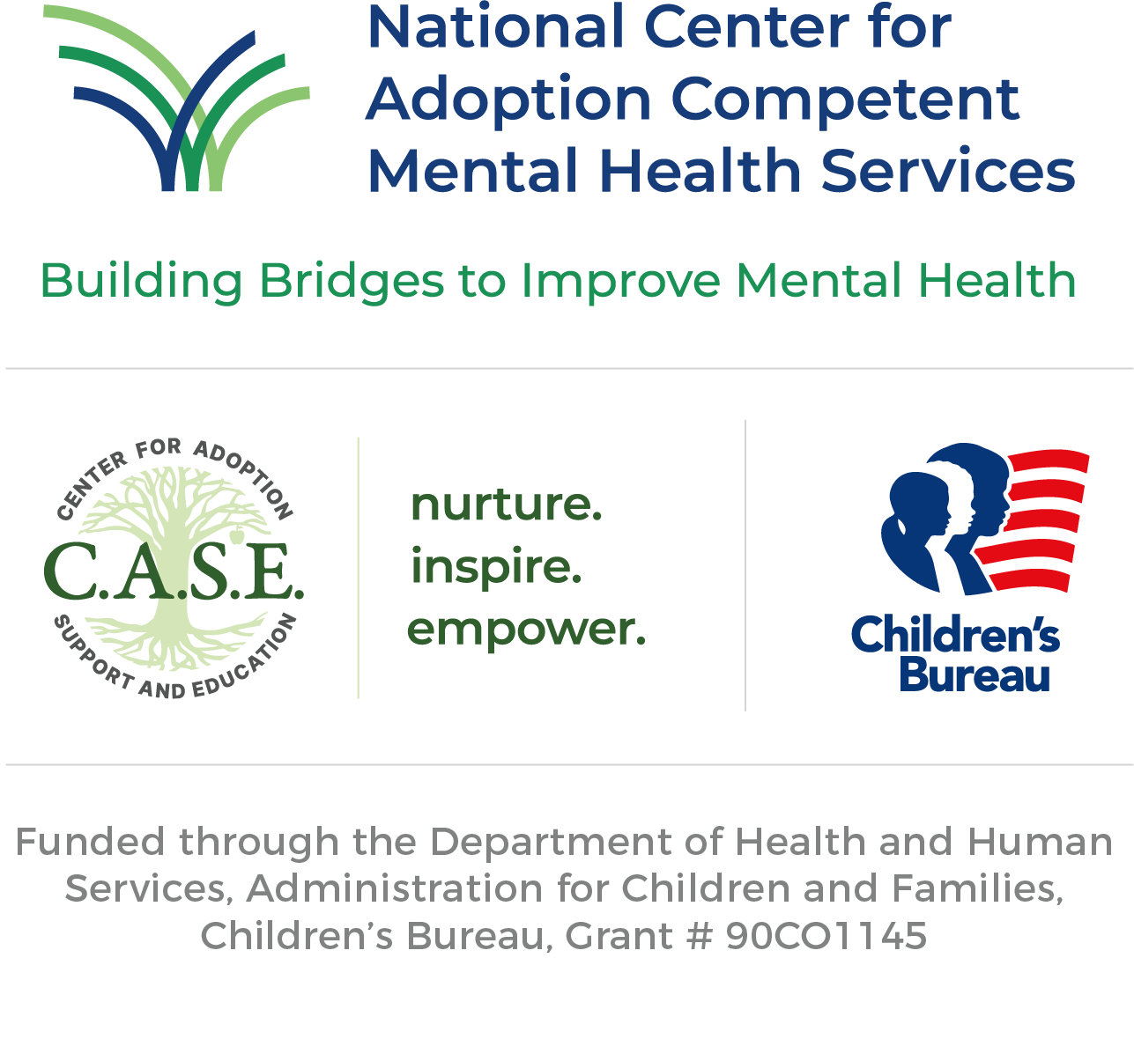
The National Center for Adoption Competent Mental Health Services was funded in Oct. 2023 by the United States Department of Health & Human Services, Administration for Children & Families, Children’s Bureau. The National Center will provide targeted technical assistance and evidence-informed training to strengthen coordination and capacity among child welfare and mental health systems to improve the quality of mental health services provided to children, young adults, and their families while in care and in adoptive and guardianship homes.
The Center for Adoption Support and Education (C.A.S.E.) is the lead organization for the National Center. C.A.S.E. is nationally recognized for its pioneering work in adoption-competent mental health services and fostering the development of a highly skilled adoption-competent workforce through its National Adoption Competency Mental Health Training Initiative (NTI), also funded by ACF.
The Children's Bureau seeks to improve the safety, permanency and well-being of children through leadership, support for necessary services, and productive partnerships with states, tribes, and communities. It has the primary responsibility for administering federal programs that support state child welfare services. Additionally, it provides matching federal funds to states, tribes, and communities to help them operate every aspect of their child welfare systems, including the prevention of child abuse and neglect, the support of permanent placements through adoption and subsidized guardianship, and the information systems necessary to support these programs.
This presentation and its content is copyright of the National Center for Adoption Competent Mental Health Services. © National Center for Adoption Competent Mental Health Services, 2024. All rights reserved.
Any redistribution or reproduction of part or all of the contents in any form is prohibited without express written permission. You may print or download to a local hard disk for personal and non-commercial use only.
Stay Connected
Become part of our community and follow the National Center on our social networks as we help impact systems change.
QUESTIONS? Call: 888-909-2209

Slide 17
Research
Engagement Outcomes Graphic – Citations
Adamsons, K., & Johnson, S. K. (2013). An updated and expanded meta-analysis of nonresident fathering and child well-being. Journal of Family Psychology, 27, 589-599.
Affronti, M. L., & Levison-Johnson, J. (2009). The future of family engagement in residential care settings. Residential Treatment for Children & Youth, 26, 257-304.
Alio, A. P., Mbah, A. K., Kornosky, J. L. Washington, D., Marty, P. J., Salihu, H. M. (2011). Assessing the Impact of Paternal Involvement on Racial /Ethnic Disparities in Infant Mortality Rates. Journal of Community Health, 36, 63-68.
Baker-Ericzén, M. J., Jenkins, M. M., & Brookman-Frazee, L. (2010). Clinician and parent perspectives on parent and family contextual factors that impact community mental health services for children with behavior problems. Child & Youth Care Forum, 39, 397-419.
Bannon, W. M., & McKay, M. M. (2005). Are barriers to service and parental preference match for service related to urban child mental health service use? Families in Society, 86, 30-34.
Bellin, M. H., Osteen, P., Heffernan, C., Levy, J. M., & Snyder-Vogel, M. E. (2011). Parent and health care professional perspectives on family-centered care for children with special health care needs: Are we on the same page? Health and Social Work, 36, 281-290.
Bendheim-Thomas Center for Research on Child Wellbeing and Social Indicators Survey Center. (2010). CPS involvement in families with social fathers. Fragile Families Research Brief, 46. Princeton, NJ and New York, NY: Bendheim-Thomas Center for Research on Child Wellbeing and Social Indicators Survey Center.
Centre for Addiction and Mental Health (CAMH). (2004). Putting Family-Centred Care Philosophy into Practice. Report by the Community Research, Planning, and Evaluation Team. Retrieved from http://www.camh.ca/en/hospital/Documents/www.camh.net/Care_Treatment/Community_and_social_supports/Social_Support/FCCI/FCC_Better_Practices_PDF.pdf
Davidson, J., Wiens, S., & Anderson, K. (2010). Creating a provincial family council to engage youth and families in child & youth mental health systems. Journal of the Canadian Academy of Child and Adolescent Psychiatry, 19, 169.
Davis, C., Claudius, M., Palinkas, L., Wong, J., & Leslie, L. (2012). Putting families in the center: family perspectives on decision making and ADHD and implications for ADHD care. Journal of Attention Disorders, 16, 675-684.
Dempsey, I., & Keen, D. (2008). A review of processes and outcomes in family-centered services for children with a disability. Topics in Early Childhood Special Education, 28, 42-52. Retrieved from http://tec.sagepub.com/content/28/1/42.full.pdf+html
Ferreira, K. (2011). Actualizing empowerment: developing a framework for partnering with families in system level service planning and delivery. Graduate Theses and Dissertations. Retrieved from : http://scholarcommons.usf.edu/etd/3103
Ferreira, K., Hodges, S., & Slaton, E. (2013). The promise of family engagement: an action plan for system-level policy and advocacy. In McDonald Culp, A. (Eds.), Child and Family Advocacy (pp. 253-268). Springer New York.
Fischer, F. (2000). Citizens, experts, and the environment: the politics of local knowledge . Durham and London: Duke University Press.
Hoagwood, K. E. (2005). Family-based services in children’s mental health: a research review and synthesis. Journal of Child Psychology and Psychiatry, 46, 690-713.
Institute for Patient and Family-Centered Care. (2009). Advancing the practice of patient-and family- centered care in primary care: how to get started. Retrieved from: http://www.ipfcc.org/pdf/GettingStarted-AmbulatoryCare.pdf
Karberg, E., Finocharo, J., & Vann, N. (2019). Father and child well-being: A scan of current research. National Responsible Fatherhood Clearinghouse. https://fatherhood.gov
Koren, P. E., Paulson, R. I., Yatchmonoff, D., Gordon, L., & DeChillo, N. (1997). Service coordination in children’s mental health: an empirical study from the caregiver’s perspective. Journal of Emotional & Behavioral Disorders, 5, 162-173.

Slide 18
Research
(cont.) Engagement Outcomes Graphic – Citations
Law, M., Rosenbaum, P., King, G., King, S., Burke-Gaffney, J., Moning-Szkut, T., Kertroy, M., Pollock, N., Viscardis, L., & Teplicky, R. (2003a). FCS Sheet 3: How does family-centred service make a difference? CanChild Centre for Childhood Disability Research, McMaster University. Retrieved from http://canchild.ca/en/childrenfamilies/resources/FCSSheet3.pdf
MacKean, G., Spragins, W., L’Heureux, L., Popp, J., Wilkes, C., & Lipton, H. (2012). Advancing family- centered care in child and adolescent mental health: A critical review of the literature. Healthcare Quarterly, 15, 64-75.
Manion, I., & Smith, E. (2011). Good things happen: Engaging families in youth mental health care. Vanier Institute of the Family, 41, 1-5. Retrieved from http://www.vanierinstitute.ca/include/get.php?nodeid=730
Miller, G. E., & Prinz, R. J. (2003). Engagement of families in treatment for childhood conduct problems. Behavior Therapy, 34, 517-534.
National Fatherhood Initiative® 2019. Father Facts: Eighth Edition. Germantown, MD: National Fatherhood Initiative®.
Osher, T. W., van Kammen, W., & Zaro, S. M. (2001). Family participation in evaluating systems of care: family, research, and service system perspectives. Journal of Emotional and Behavioral Disorders, 9, 63-71.
Robst, J., Armstrong, M., Dollard, N., Rohrer, L., Sharrock, P., Batsche, C., & Reader, S. (2013). Characteristics related to family involvement in youth residential mental health treatment. Children and Youth Services Review, 35, 40-46. Retrieved from http://dx.doi.org/10.1016/j.childyouth.2012.10.004
Osher, T. W., van Kammen, W., & Zaro, S. M. (2001). Family participation in evaluating systems of care: family, research, and service system perspectives. Journal of Emotional and Behavioral Disorders, 9, 63-71.
Robst, J., Armstrong, M., Dollard, N., Rohrer, L., Sharrock, P., Batsche, C., & Reader, S. (2013). Characteristics related to family involvement in youth residential mental health treatment. Children and Youth Services Review, 35, 40-46. Retrieved from http://dx.doi.org/10.1016/j.childyouth.2012.10.004
Slaton, A. E., Cecil, C. W., Lambert, L. E., King, T., & Pearson, M. M. (2012). What a difference family-driven makes: stories of success and lessons learned. American journal of community psychology, 49, 538-545.
Smith, J., Wohlstetter, P., Kuzin, C. A., & De Pedro, K. (2011). Parent involvement in urban charter schools: new strategies for increasing participation. School Community Journal, 21, 71-94.
Tambuyzer, E., & Van Audenhove, C. (2013). Service user and family carer involvement in mental health care: divergent views. Community Mental Health Journal, 49, 675-685.
Whitney, S. D., Prewett, S., Wang, Z., & Chen, H. (2018). FATHERS’ IMPORTANCE IN ADOLESCENTS’ ACADEMIC ACHIEVEMENT. International Journal of Child, Youth and Family Studies, 8(3/4), 101-126. https://doi.org/10.18357/ijcyfs83/4201718073

