Slide 1
Supporting Transgender and Gender Expansive Youth
July 16, 2024

Slide 2
Introduction
Erin Bader (pronouns: she/her)
Director of Knowledge and Dissemination – CASE
Phii Regis (pronouns: they/them)
Director, All Children – All Families

Slide 3
Equity and Inclusion Agreements
Listen to understand and speak with respect
Be kind and brave
Center learning and growth
Stay engaged

Slide 4
Agenda & Webinar Objectives
Introductions and webinar objectives
Overview of the National Center
Quick SOGIE Review
Experiences of Transgender and Gender-Expansive Youth
Tips for Supporting Transgender and Gender-Expansive Youth
Q & A
Participants Will:
Understand the purpose of the National Center
Understand how to welcome, affirm, and best serve transgender and gender-expansive youth in out-of-home care
Understand the diversity of identities and experiences among transgender and gender-expansive youth
Understand the mental health experiences of these youth
Learn how to assess whether a mental health provider can provide affirming services
Review promising practices for creating a gender inclusive environment in child welfare, mental health, and broader child-serving systems
Understand strategies for ensuring you are an affirming presence in the lives of transgender and gender expansive youth

Slide 5
Starting With WHY
We envision a world where ALL children and their families who have experienced the child welfare system reach their full potential
We align changemakers in child serving systems to collaborate to advance and sustain adoption competency
We partner to build culturally and linguistically accessible mental health services that are uniquely designed to meet the needs of families who have experienced the child welfare system
WHY?
HOW?
WHAT?

Slide 6
Children and Youth’s Mental Health
Experiencing child welfare and foster care can negatively impact the child’s present and future functioning, mental health, and well-being.
3–4 times more likely to be diagnosed with a mental health disorder¹
Experience higher rates of various mental health disorders, including attention deficit hyperactivity disorder (ADHD), depression, anxiety, oppositional defiant disorder (ODD), conduct disorder, post-traumatic stress disorder (PTSD), reactive attachment disorder, and behavioral problems, as compared with the general population²
Face disproportionate use of psychotropic medication for compared with children not in care. 1 in 9 Black children and 1 in 7 Native American children spend part of their childhood in foster care
60% Percent that go on to have lifelong disorders
Greiner & Beal, 2017
Greiner & Beal, 2017; Havlicek et al., 2013; Lohr & Jones, 2016; McMillen et al., 2005; Tarren-Sweeney, 2008

Slide 7
What is Adoption Competence?
Not a single practice but a comprehensive set of knowledge, values, and skills competencies​
Attachment-focused
Trauma-informed
Healing occurs best in the context of family
Addresses core issues such as loss, rejection, guilt, grief
Therapeutic parenting: reframe behaviors based on a deep understanding of the child’s experiences​
All children, youth, and families that have encountered the child welfare system will benefit from Adoption Competent Mental Health Services.

Slide 8
Application of Racial and Broader Equity Throughout the National Center
Accessible and Inclusive
Topics within the Hub reflect the needs of underserved communities
Highlight resources that are for underserved communities
The Hub will be transparent about the process used to choose the material included
Dissemination
Diversify Audience
Direct outreach to historically trusted institutions and service providers
Develop partnership with associations supporting underserved communities
Build report and increase brand recognition while increasing a presence in underserved communities
Engage Communities
Utilize a comprehensive assessment of site readiness and willingness to address systemic barriers
Work with sites to engage individuals most impacted by systems of care to identify barriers
Use affinity and focus groups to determine where the site is on the continuum for anti-oppression and anti-racism work.
Knowledge Hub
Technical Assistance

Slide 9
Technical Assistance (TA)
Universal TA
Knowledge Hub
Diverse group of resources
Connection to peer learning
Promotion of equity in service array
Newsletters
Webinars and toolkits
Intensive TA
Cross system collaboration
Multi-disciplinary expertise
Integration of youth and family voice
Attention to sustainability of work
Resources and tools to achieve desired outcomes

Slide 10
Supporting the Mental Health Needs of Transgender and Gender Expansive Youth

Slide 11
Key Terms & Concepts

Slide 12
Key Concepts
Sexual Orientation
Gender Identity
Gender Expression
Gender Binary vs. Spectrum

Slide 13
Gender Identity (Related Terms)
Two key terms related to gender identity
Cisgender
Sex Assigned At Birth
=
Gender Identity
Transgender
Sex Assigned At Birth
≠
Gender Identity

Slide 14
Binary View of SOGIE
Assigned Male at Birth
Assigned Female at Birth
Identifies as a man
Identifies as a woman
“Looks & acts like a man”
“Looks & acts like a woman”
Perceived as a man
Perceived as a woman
Attracted to women
Attracted to men

Slide 15
Binary View of SOGIE
Assigned Male at Birth
Assigned Female at Birth
Uses he/him pronouns
Uses she/her pronouns
Way too limited!

Slide 16
Sample Overview - SOGI
Sexual Orientation
29.5% Gay or Lesbian
27.7% Bisexual/Biromantic
15.3% Pansexual/Panromantic
10.3% Asexual/Ace/Greysexual
10% Queer
Gender Identity
31.4% Transgender
26.6% Non-Binary
28.4% GNC/Genderqueer/Gender Fluid
15% Questioning/Unsure

Slide 17
Mental Health & LGBTQ+ Youth

Slide 18
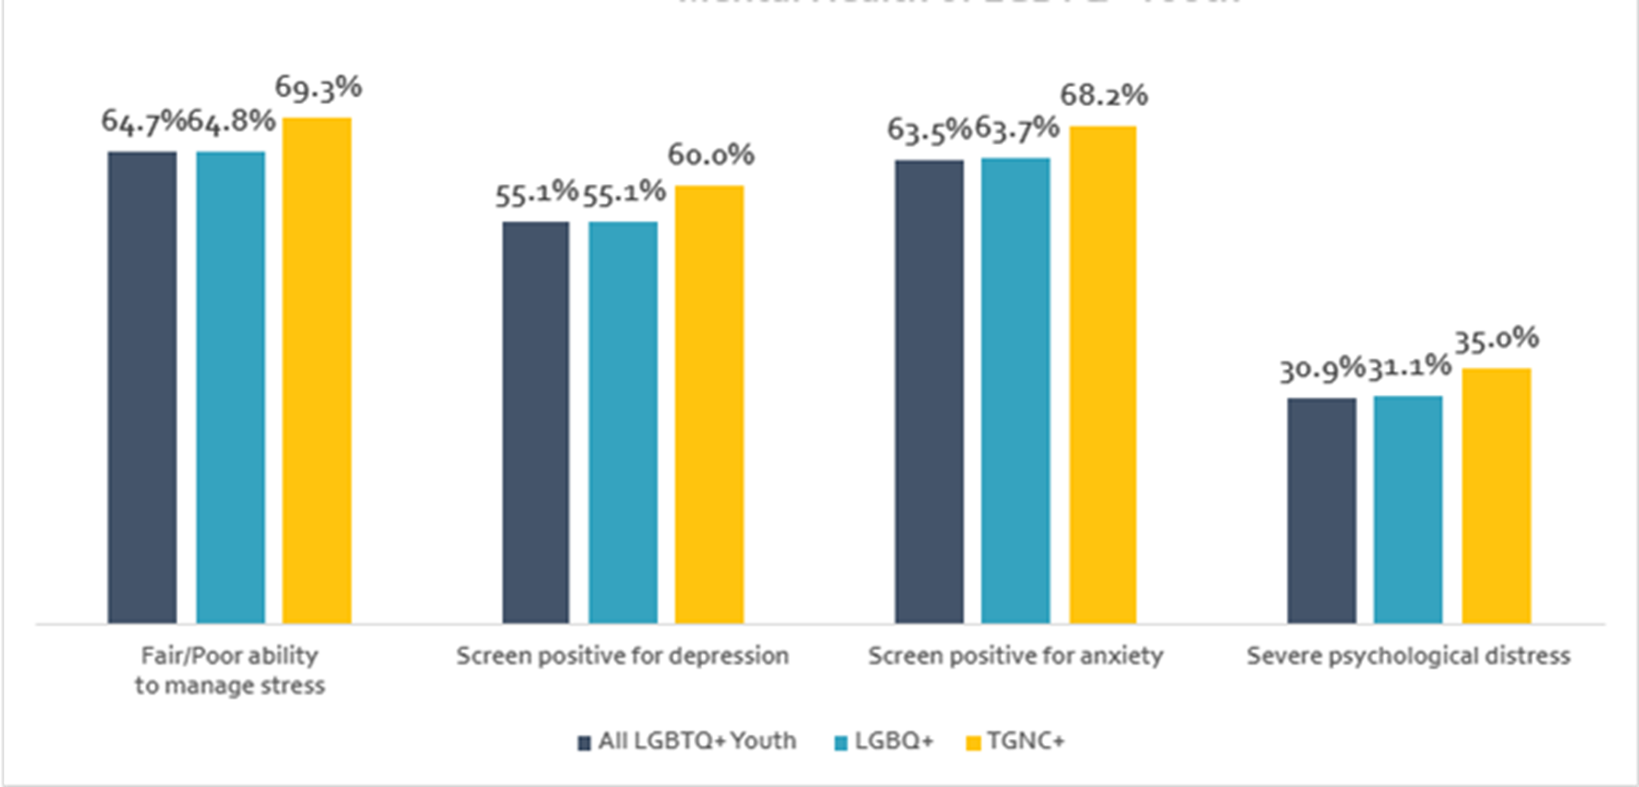
Mental Health
According to the Center for Disease Control’s 2021 Youth Risk Behavior Surveillance Survey, 42.3% of high school age youth of all high school aged youth reported feeling “sad or hopeless” for 2+ weeks.

Slide 19
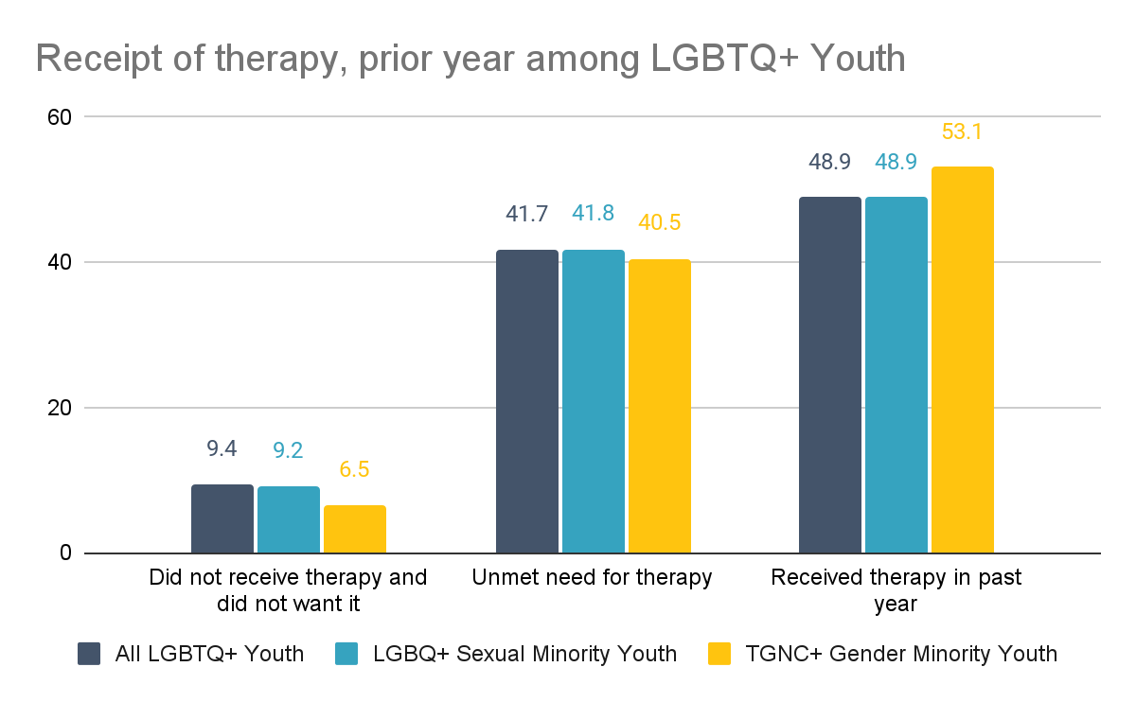
Therapy and Access to Therapy

Slide 20
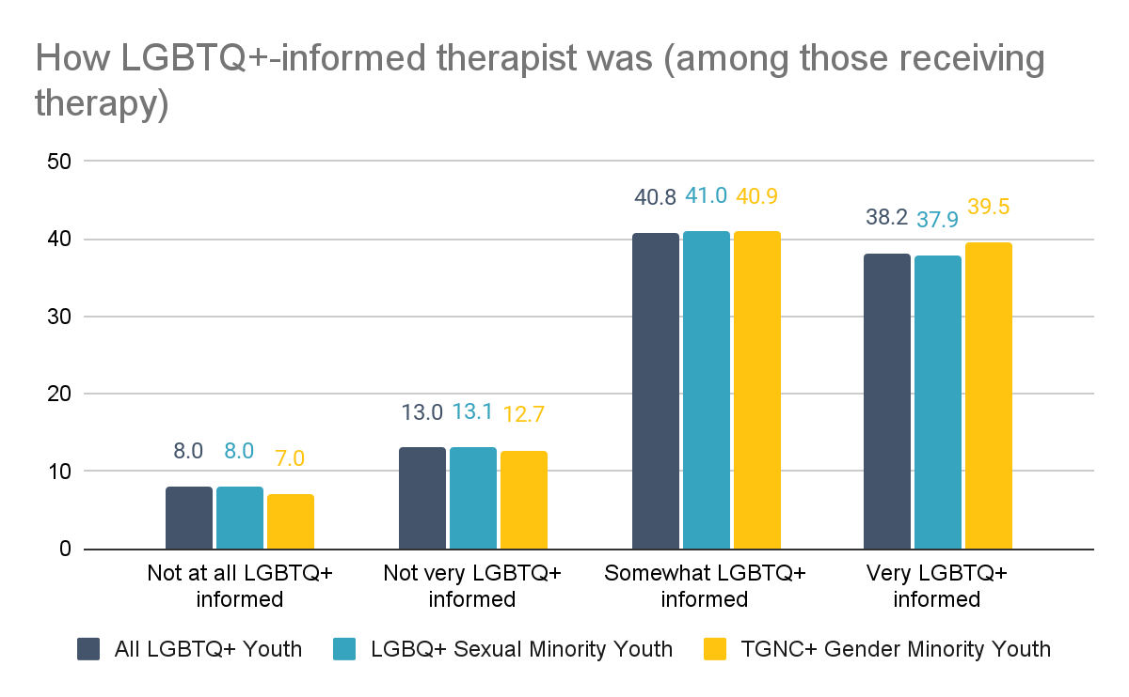
How LGBTQ+-Informed Therapists Are

Slide 21
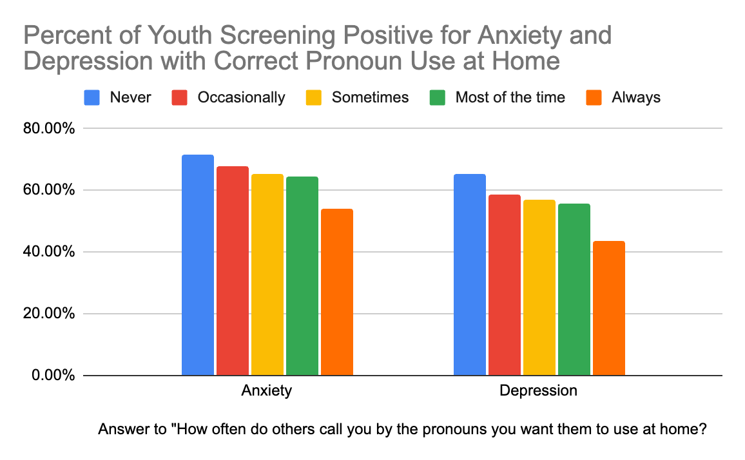
Mental Health + Misgendering at Home

Slide 22
What To Do
Supporting Mental Health
Connect with local schools and youth-serving organizations to share information about LGBTQ+-affirming services and help reduce the stigma of seeking counseling.
Advocate for policies and practices that encourage transgender, gender non-conforming, and non-binary youth to be to be their full authentic self in counseling sessions without fear of being outed to their parents, caregivers, and/or family by ensuring their chosen names and pronouns are kept confidential.

Slide 23
Pronouns 101

Slide 24
Pronoun Best Practices
Use someone’s chosen pronouns unless asked not to for specific reasons (e.g., safety or privacy).
When you don’t know someone’s pronouns:
If you don’t know, ask.
You can (and should) avoid using pronouns for someone when you don’t know them. Just use their name!
If/when you make a mistake:
Apologize and move on quickly.
Gently and consistently correct others who misgender someone

Slide 25
Pronoun Best Practices
Create opportunities for people to share their pronouns
One-on-one conversations
In meetings
In your e-mail signature next to your name:
In your display name on Zoom/Virtual Platform(s)

Slide 26
Beyond “They” Pronouns
They/them pronouns are not the only pronouns outside of the binary:
Neopronouns: Ze/Zir, Ze/Hir, Fae/faer, & more
Pronoun options may evolve similar to other terms used by the LGBTQ community
Some people do not want to use pronouns at all, and may use their name instead of a pronoun:
Nonouns

Slide 27
Using Pronouns Beyond the Binary
GENDERED/BINARY
BEYOND THE BINARY
She/Her/Hers
He/Him/His
They/Them/Theirs
Ze/Zir/Zirs
Ze/Hir/Hirs
She is here now.
He is here now.
They are here now.
Ze is here now.
Ze is here now.
Her phone call just started.
His phone call just started.
Their phone call just started.
Zir phone call just started
Hir phone call just started
She excused herself from the meeting.
He excused himself from the meeting.
They excused themself from the meeting.
Ze excused zirself from the meeting.
Ze excused hirself from the meeting.
That seat is hers.
That seat is his.
That seat is theirs.
That seat is theirs.
That seat is hirs.
Let's wait for her.
Let's wait for him.
Let's wait for them.
Let's wait for zir.
Let's wait for hir.

Slide 28
Keep Open
“You don’t have to keep up dear, you just have to keep open.”
- Mrs. Madrigal, Tales of the City

Slide 29
Barriers Faced In Out-of-Homecare
Bias and lack of respect for gender identity and expression
Verbal and physical harassment
Inappropriate placements
Unmet healthcare needs
Barriers in other systems of care (e.g., school)
Lack of inclusive community resources

Slide 30
Health Care: Transgender Youth
Not all transgender people choose medical intervention
“Gender Dysphoria” is a diagnosable condition, not a mental illness, but the diagnosis is needed for prescribed hormone therapy
Prescribed hormone therapy is covered by Medicaid
Service providers cannot nullify active treatment plans
Alternatives to professional treatment can be risky for youth

Slide 31
Conversion Therapy is Not Effective, It is Extremely Harmful
Conversion therapy is rejected by all mainstream medical and mental health organizations:
American Academy of Pediatrics
American Assc. For Marriage and Family Therapy
American Counseling Association
American Medical Association
American Psychiatric Association
American Psychoanalytic Association
American Psychological Association
American School Counselor Association
Pan American Health Organization
Conversion therapy has not been proven to change a person’s sexual orientation, gender identity or expression by any credible scientific study.
Both individuals (Dr. Robert Spitzer) and groups (Exodus International) that have previously supported conversion therapy have said it is ineffective.

Slide 32
Engage Early and Often
Transgender, non-binary, and gender expansive young people should be actively and intentionally engaged in ALL things that impact them directly.
Young people should be viewed as the expert when it comes to their identity, the development of their goals, the identification of the supports that make the best sense for them.

Slide 33
What Does Active Engagement Look Like?
Active engagement goes a long way to develop professional relationships that help young people feel safe, seen, and heard. Consider questions that are related to supporting youth experiencing congregate care:
Who do you want to stay/be in connection with while in congregate care?
Do you have any key relationship(s) such as a friend, romantic partner, or others to stay in touch with?
What is the best way to go about keeping those connections?

Slide 34
Keep in Mind
Avoid asking questions that assume a youth has family members with whom they are in contact
Family might be defined as biological, or they might be friends and community members
Young people in congregate care need access to those individuals within their definition of family
Do not assume that friend connections are romantic or related to a youth’s sexual orientation

Slide 35
Privacy and Confidentiality
Programs should have policies in place to ensure the privacy of
all residents, including transgender, non-binary youth, and gender expansive.
Protect personal data and information including:
youth’s legal name (sometime referred to as dead name)
sex assigned at birth
transgender status,
as well as medical information related to gender-affirming care for example
When talking to team members and adults in the youth’s life, staff should NOT assume that youth has shared all aspects of their identity with their entire team.

Slide 36
Supporting Connections
Consider offering all activities to all youth, as stereotypical gendered activities may not be of interest to only those we assume would be interested.
Work closely with outside resources and community organizations, which provide transgender and non-binary youth with the activities, supports, and resources they need.

Slide 37
Supporting Connections
Youth should have access to activities that are available to their same-age peers including sports, drama, clubs, and just hanging out with their friends.
Take time to find out the interests of youth clients.
Participation in activities or groups in the community can support normalcy and the development of relationships.

Slide 38
Existing Expertise
Review current policy and practice to see what you are already doing that supports doing this work
Trauma informed already says this
We are all about supporting Adolescent Development – which includes (gender) identity development

Slide 39
Staff Training
Science-based sexuality and gender training, which includes addressing myths and stereotypes of this population, as well as identifying biases should be required for all staff and includes:
Prevention of oversexualizing all youth; specifically, BIPOC youth
Developmentally appropriate exploration of sexuality and gender identity development in adolescence

Slide 40
Respect, Affirm, and Celebrate
Transgender, non-binary, and gender expansive youth can express their gender in a way that is authentic and affirming to them.
All staff (including reception, maintenance, etc.) should be ready to interact with all youth respectfully and with authenticity including consistently using youth’s chosen name and pronouns
Use inclusive documentation regarding names and pronouns. For transgender, non-binary, and gender expansive BIPOC youth take extra care to ensure correct spelling and pronunciation of chosen name

Slide 41
Creating Gender-Inclusive Environments

Slide 42
Responding in the Moment
1. Acknowledge your own feelings (internally!)
2. Thank them for sharing
3. If applicable:
Ask what you can do to support them
Ask who else knows their pronouns
Ask if there is any time when you should not use their chosen pronouns (e.g., safety or privacy)

Slide 43
Gender-Affirming Language About a Trans Girl
“She’s a girl who was assigned male at birth.”
“He’s a boy but he feels like a girl.”
43
Notes:
43

Slide 44
Gender-Affirming Language
Reagan is genderqueer and uses they/them pronouns.
Reagan identifies as genderqueer. She uses they/them pronouns
44
Notes:
44

Slide 45
Gender-Affirming Language
Transgender/Trans Folks/Folx
Gender Creative/Diverse Community
Genderqueer Youth
Nonbinary Friends
Gender Nonconforming Person
Transgenders
A Transgender
Transgendered
Transvestite
Tranny
45
Notes:
45

Slide 46
Other Examples of Gendered Language
Source: Qmunity (2012)

Slide 47
Gender-Neutral Honorifics
People using pronouns outside of the gender binary (e.g., they/them, ze/zir, ze/hir, etc.) often do not use titles like “Mr.” or “Mrs.”
1. Avoid assuming a client uses “Mr./Mrs.” unless their chosen title is known
2. Ask if they have a preferred/chosen title
3. Some in the trans and non-binary community use “Mx.” while some may prefer not to use titles at all.

Slide 48
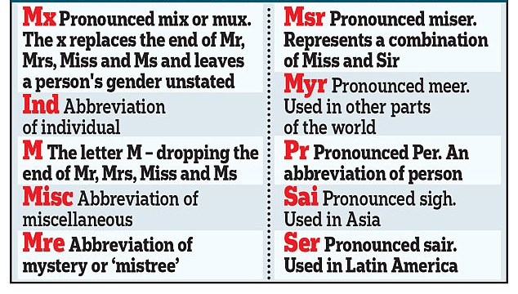
Gender-Neutral Honorifics
Source: Qmunity (2012)

Slide 49
Why do Chosen Names Matter?
Using a person’s chosen name affirms their identity and avoids doing harm
Refusing to use a person’s chosen name
Often uncomfortable and hurtful
May damage trust and compromise ability to serve them
Use someone’s chosen name unless asked not to for specific reasons (e.g., safety or privacy)
Create opportunities to share chosen name on forms
Source: Hunter, D. (2011)

Slide 50
Forms & Gender Inclusion
Review all forms for language rooted in “heterocentrism” or “cissexism”
Gender-neutral
Use “Parent 1” or “Child 1” instead of “Mom” or “Daughter”
Chosen names
If legal name is needed, a form can ask for “Legal name” as well as “Chosen/ preferred name.”
Pronouns
Gender other than Male or Female

Slide 51
Practice!

Slide 52
Arlicia Case Study
Entered Care:
Arlicia is a young trans girl whose mother is incarcerated and she entered foster care after suffering physical abuse from her father who was “beating the gay out of her.”
Experiences in Care:
Arlicia has lived in two group homes (both all-male) and attended two schools in the past year.
She recently decided to socially transition by asking people to no longer use her given name and to dress in traditionally female clothing.
While she feels supported by her friends, teachers and the Gay Straight Alliance at school, the staff and peers at her group home refuse to call her Arlicia, do not allow her to wear “girls’” clothing in the home, and she must share a bathroom with the other (male) residents. She is often bullied there and keeps herself extremely isolated.
Arlicia has been arrested twice in the past month for stealing clothing, make-up and shoes.
Current Situation:
Amy (caseworker) has decided to ask Ms. Barker, a long-time foster mother experienced with teens, to consider taking Arlicia into her home. While Ms. Barker has been a stellar foster parent to many children over the years, she has never cared for a transgender teen before, and has a number of misconceptions about transgender youth.

Slide 53
Arlicia Case Study
Ms. Barker’s questions and concerns
“I’ve still got my 6-year old grandson living in the home. I don’t think Arlicia will be a very good influence on a young boy.”
“You say ‘she’ is nice and a good student, then why has she been arrested twice in the last month?”
“What are they going to say at church if I’ve got a child like that in my home? Am I supposed to bring her with me, looking like that?”
How would you respond to these concerns? (Use Chat)

Slide 54
Q&A

Slide 55
Action Steps
1
2
3
4
Complete a brief survey evaluating this webinar
https://go.unl.edu/ncwebinar
Visit The Center website for more information
bridges4mentalhealth.org
Email your questions to:
Sign up for emails notification and the newsletter
Connect With Us
Mary Wichansky, National Center Director wichansky@adoptionsupport.org

Slide 56
Thank you!
The National Center for Adoption Competent Mental Health Services was funded in Oct. 2023 by the United States Department of Health & Human Services, Administration for Children & Families, Children’s Bureau. The National Center will provide targeted technical assistance and evidence-informed training to strengthen coordination and capacity among child welfare and mental health systems to improve the quality of mental health services provided to children, young adults, and their families while in care and in adoptive and guardianship homes.
The Center for Adoption Support and Education (C.A.S.E.) is the lead organization for the National Center. C.A.S.E. is nationally recognized for its pioneering work in adoption-competent mental health services and fostering the development of a highly skilled adoption-competent workforce through its National Adoption Competency Mental Health Training Initiative (NTI), also funded by ACF.
The Human Rights Campaign (HRC) is a subject matter consultant with the National Center. HRC is helping to develop and review materials to ensure inclusivity for LGBTQ+ populations. The HRC Foundation's All Children - All Families program provides educational resources, training and technical assistance on LGBTQ+ inclusion for child welfare systems. Since 2007, ACAF has been the go-to resource for agencies looking to truly welcome and affirm LGBTQ+ prospective parents and transform their service delivery for LGBTQ+ youth in out-of-home care.
On-Demand Webinars: hrc.im/acaf-webinar-archive
Monthly E-Newsletter: hrc.im/field-forward
Project Email: acaf@hrc.org
Web: hrc.im/acaf
This presentation and its content is copyright of the National Center for Adoption Competent Mental Health Services – © National Center for Adoption Competent Mental Health Services, 2024. All rights reserved.
Any redistribution or reproduction of part or all the contents in any form is prohibited without express written permission. You may print or download to a local hard disk for personal and non-commercial use only.

Slide 57
Works Cited
Hunter, D. Using Discomfort Zones for Learning. (Training for Change, 2011) Handout.
Qmunity. Gender Neutral Language Sheet. (2012). Available at:. https://qmunity.ca/resources/gender-neutral-language-sheet/.

